Slide 1
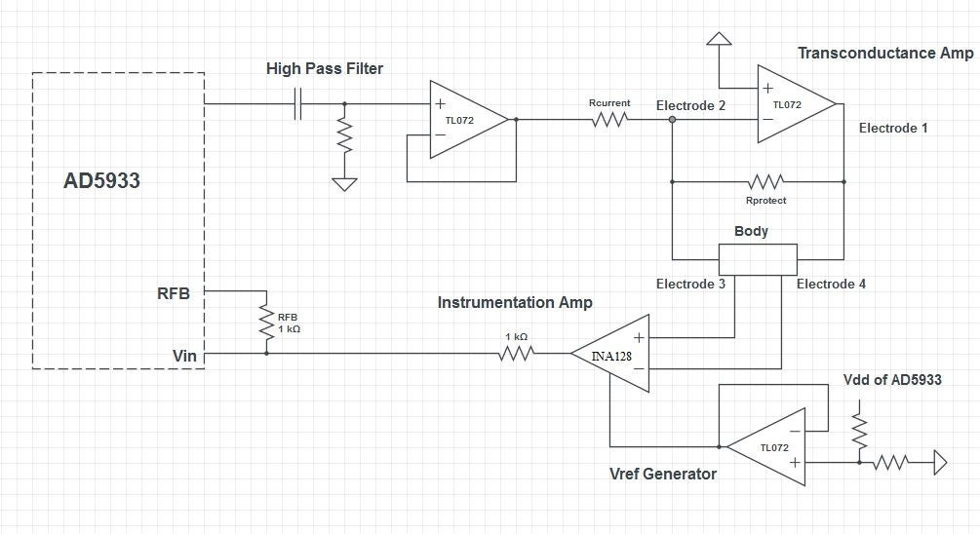
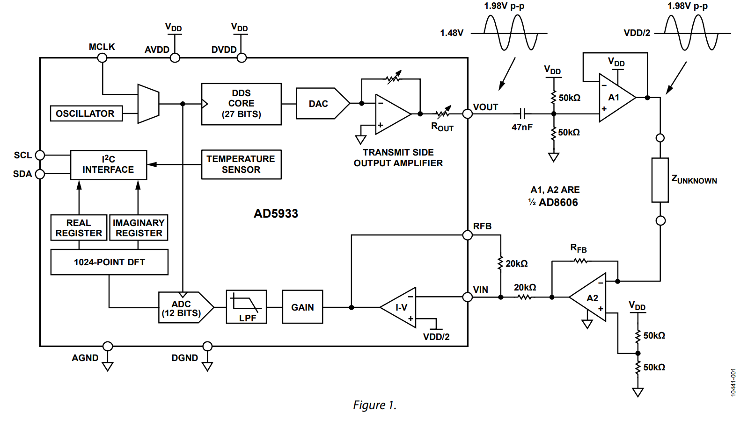
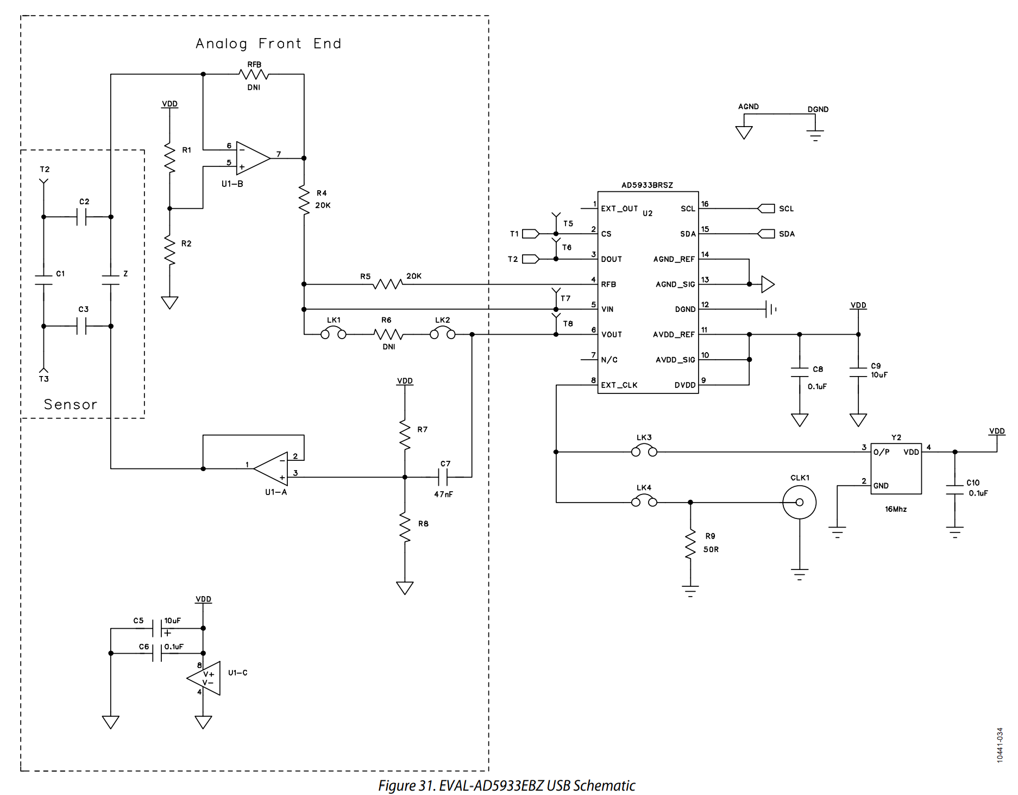
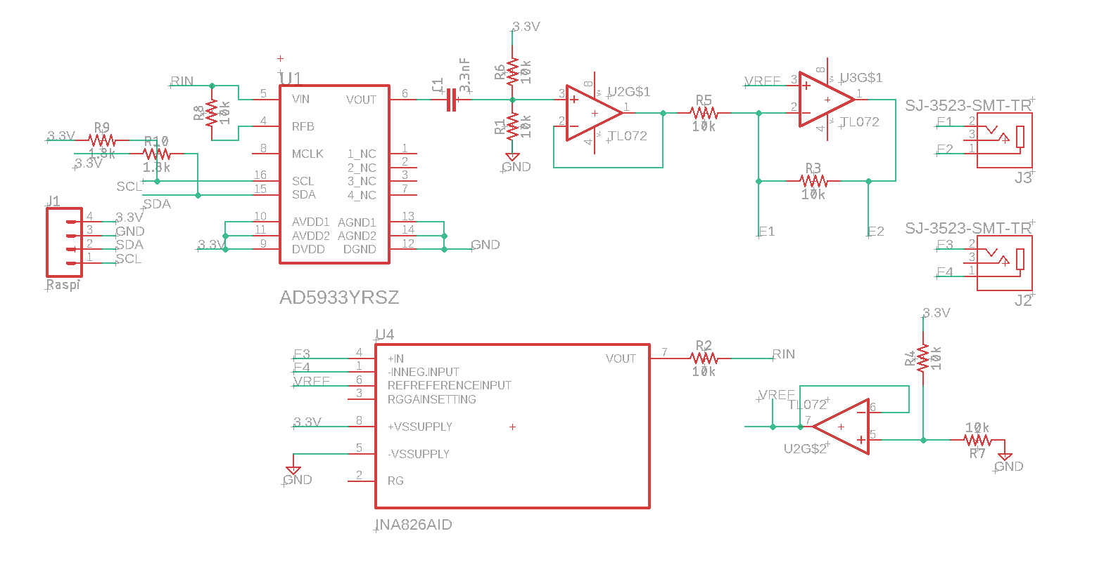
Instructables
Analog Devices Evaluation Board
Analog Devices Evaluation Board
Senior Design 2022

Slide 2
Combined Circuit
AD8606
100k
Changed
Resistors
1M
10nF
100k
200k
3.3V
1K
20k
IN A826
20k
Evaluation Board
Same
Voltage Ref
but with Buffer
GND
By cutting jumpers you can enable
Left or Right circuit
You either have one electrode plug on left side
Or you have two on right side

Slide 3
